Slide 1


Using Data Flow Diagrams
CS456: Advanced System Analysis & Design
Session 4
Ferdinand Hiagbe

Slide 2


Objectives of this lesson
Comprehend the importance of using logical and physical data flow diagrams (DF Ds) to graphically depict movement for humans and systems in an organization
Create, use, and explode logical DFDs to capture and analyze the current system through parent and child levels
Develop and explode logical DFDs that illustrate the proposed system
Produce physical DFDs based on logical DFDs you have developed

Slide 3
Data Flow Diagrams
Graphically characterize data processes and flows in a business system
Depict:
System inputs
Processes
Outputs

Slide 4
Advantages of the Data Flow Approach
Freedom from committing to the technical implementation too early
Understanding of the interrelatedness of systems and subsystems
Communicating current system knowledge to users
Analysis of the proposed system

Slide 5
Data flow diagram symbols
Section 1/5

Slide 6
Basic Symbols
A double square for an external entity
An arrow for movement of data from one point to another
A rectangle with rounded corners for the occurrence of a transforming process
An open-ended rectangle for a data store

Slide 7
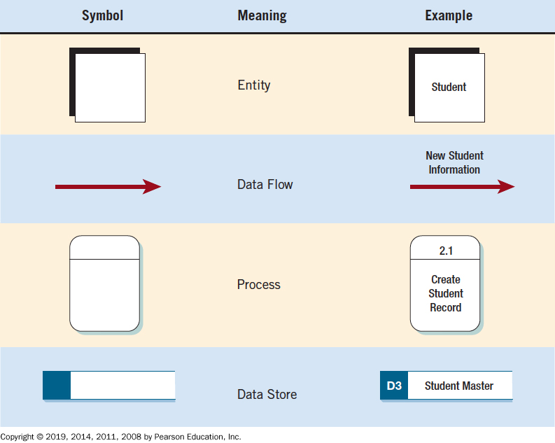
Figure 7.1 The Four Basic Symbols Used in Data Flow Diagrams, Their Meanings, and Examples

Slide 8
External Entities
Represent another department, a business, a person, or a machine
A source or destination of data, outside the boundaries of the system
Should be named with a noun

Slide 9
Data Flow
Shows movement of data from one point to another
Described with a noun
Arrowhead indicates the flow direction
Represents data about a person, place, or thing

Slide 10
Process
Denotes a change in or transformation of data
Represents work being performed in the system
Naming convention:
Assign the name of the whole system when naming a high-level process
To name a major subsystem attach the word subsystem to the name
Use the form verb-adjective-noun for detailed processes

Slide 11
Data Store
A depository for data that allows viewing, addition, and retrieval of data
Named with a noun, describing the data
Data stores are usually given a unique reference number, such as D1, D2, D3
Represents a:
Database
Computerized file
Filing cabinet

Slide 12
Data flow diagram levels
Section 2/5

Slide 13
Figure 7.2 Steps in Developing Data Flow Diagrams (1 of 3)
Developing Data Flow Diagrams Using a Top-Down Approach
Make a list of business activities and use it to determine various
External entities
Data flows
Processes
Data stores

Slide 14
Figure 7.2 Steps in Developing Data Flow Diagrams (2 of 3)
Create a context diagram that shows external entities and data flows to and from the system. Do not show any detailed processes or data stores.
Draw Diagram 0, the next level. Show processes, but keep them general. Show data stores at this level.
Create a child diagram for each of the processes in Diagram 0.
Check for errors and make sure the labels you assign to each process and data flow are meaningful.

Slide 15
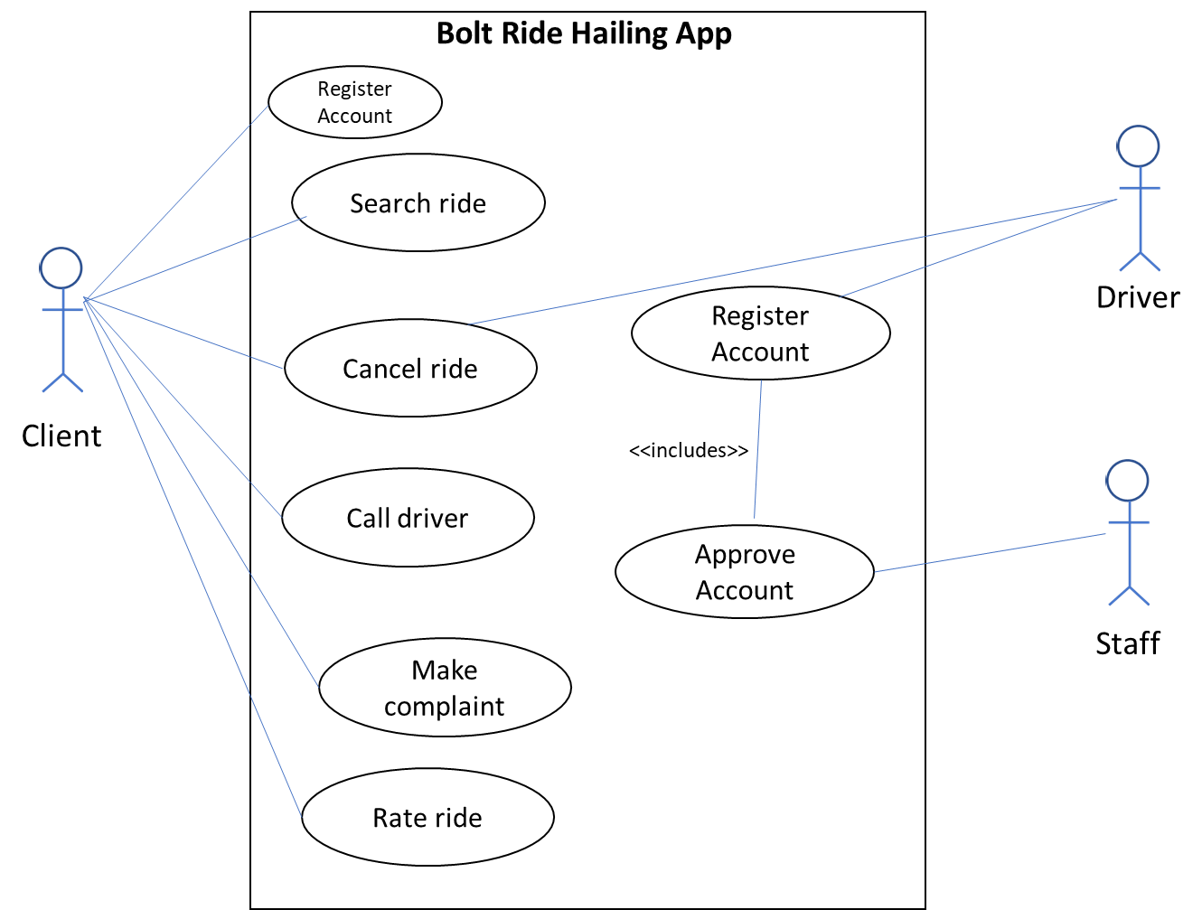
Example - Bolt
External entities
Client
Driver
Staff
Data flows
Request
Cancellation
Complaints
Rating
Client information
Driver information
Processes
Register Account
Register driver account
Approve registration
Search ride
Cancel ride
Call driver
Rate ride
Make complaint
Data stores
Driver Account
Client profile
Ride booking information
Client Complaints
Ride Ratings
Call details

Slide 16
Figure 7.2 Steps in Developing Data Flow Diagrams (3 of 3)
Develop a physical data flow diagram from the logical data flow diagram. Distinguish between manual and automated processes, describe actual files and reports by name, and add controls to indicate when processes are complete or errors occur.
Partition the physical data flow diagram by separating or grouping parts of the diagram in order to facilitate programming and implementation.

Slide 17
Creating the Context Diagram
The highest level in a data flow diagram
Contains only one process, representing the entire system
The process is given the number 0
All external entities, as well as major data flows are shown

Slide 18
Basic Rules
The data flow diagram must have one process
Must not be any freestanding objects
A process must have both an input and output data flow
A data store must be connected to at least one process
External entities should not be connected to one another

Slide 19
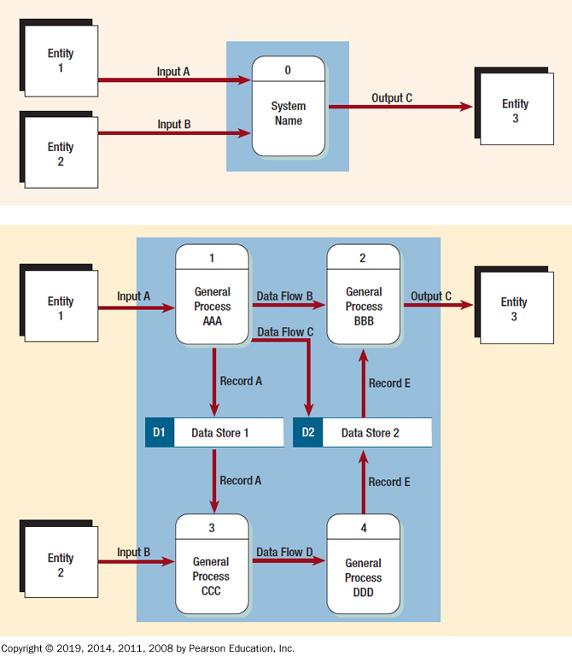
Figure 7.3 Context Diagram

Slide 20
Example – The Bolt Ride System
Client
Get ride
Book ride
Rate ride
0
Staff
Make complaints
Bolt Ride Hailing System
Approve account
Driver
Register account

Slide 21
Example – The Library System
0
Register members
Librarian
Library Management System
Add books
Capture payments

Slide 22
Example – The MoMo
Loans Operators
GRA
Get loan
Subscribers
Transfer money
pay loan
Pay e-levy
0
Pay taxes
Other Telcos
MTN MoMo
System
Get e-cash
Make payment
Merchants
Get payment
Utility companies
Transfer money
Transfer money
Make payment
Transfer money
Other Payment Gateways
Banks

Slide 23
Drawing Diagram 0 (1 of 2)
The explosion of the context diagram
May include up to nine processes
Each process is numbered
Major data stores and all external entities are included

Slide 24
Drawing Diagram 0 (2 of 2)
Start with the data flow from an entity on the input side
Work backward from an output data flow
Examine the data flow to or from a data store
Analyze a well-defined process
Take note of any fuzzy areas

Slide 25
Figure 7.3 Note Greater Detail in Diagram 0

Slide 26
Example – The Bolt Ride System
Client
External entities
Client
Driver
Staff
Data flows
Request
Cancellation
Complaints
Rating
Call
Client information
Driver information
Processes
Register Account
Register driver account
Approve registration
Search ride
Cancel ride
Call driver
Rate ride
Make complaint
Data stores
Driver Account
Client profile
Ride booking information
Client Complaints
Ride Ratings
Call details
Provide Client information
Request ride
Provide complaint details
Enter rating details
Place call
Make Cancellation
1
3
5
4
6
7
Register Client Account
Book Ride
Make Call
Cancel Ride
Make complaint
Rate Ride
Place call
D1
Client Account
D2
Ride information
D3
Call details
D4
Cancellation details
D5
complaints details
D6
Ratings
D7
Driver Account
Driver
Provide driver & car information
2
Approve driver & car information
Staff
Register Driver Account

Slide 27
Data Flow Diagram Levels
Data flow diagrams are built in layers
The top level is the context level
Each process may explode to a lower level
The lower level diagram number is the same as the parent process number
Processes that do not create a child diagram are called primitive

Slide 28
Creating Child Diagrams (1 of 2)
Each process on diagram 0 may be exploded to create a child diagram
A child diagram cannot produce output or receive input that the parent process does not also produce or receive
The child process is given the same number as the parent process
Process 3 would explode to Diagram 3

Slide 29
Creating Child Diagrams (2 of 2)
Entities are usually not shown on the child diagrams below Diagram 0
If the parent process has data flow connecting to a data store, the child diagram may include the data store as well
When a process is not exploded, it is called a primitive process

Slide 30
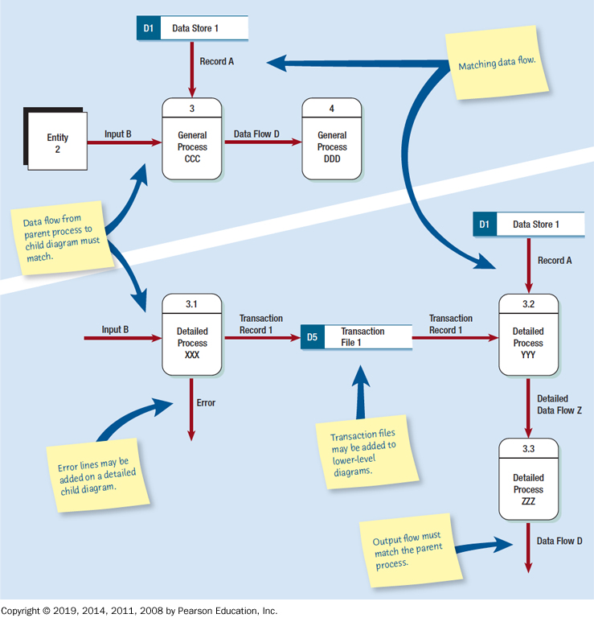
Figure 7.4 Differences between the Parent Diagram (above) and the Child Diagram (Below)

Slide 31
Data Flow Diagrams Error Summary
Forgetting to include a data flow or pointing an arrow in the wrong direction
Connecting data stores and external entities directly to each other
Incorrectly labeling processes or data flow
Including more than nine processes on a data flow diagram
Omitting data flow
Creating unbalanced decomposition (or explosion) in child diagrams

Slide 32
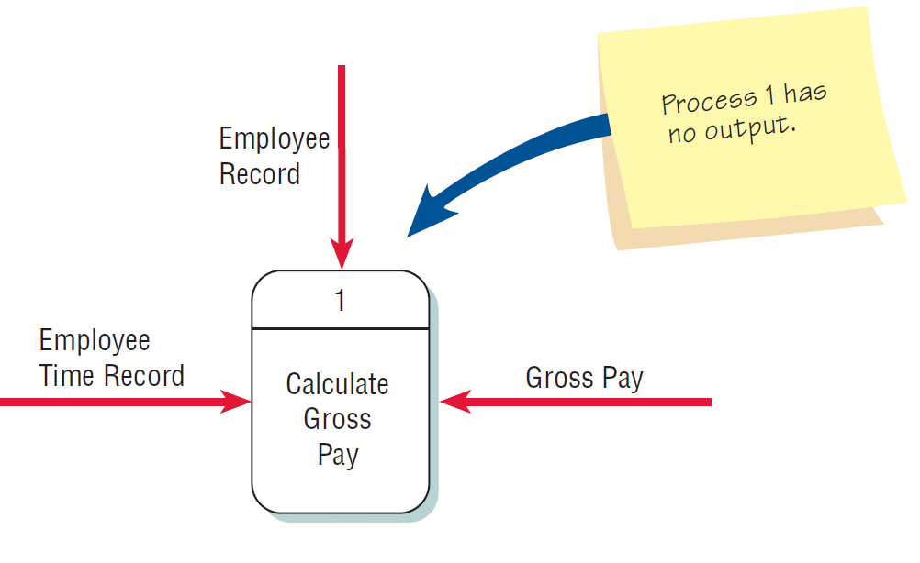
Figure 7.5 Checking the Diagrams for Errors
Forgetting to include a data flow or pointing an arrow in the wrong direction

Slide 33
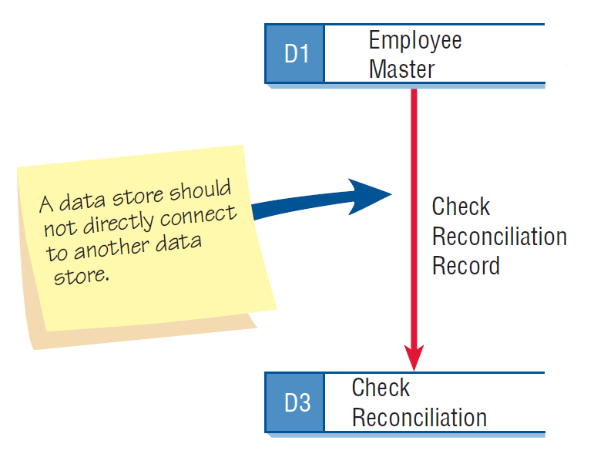
Figure 7.5 Checking the Diagrams for Errors (2 of 2)
Connecting data stores and external entities directly to each other

Slide 34
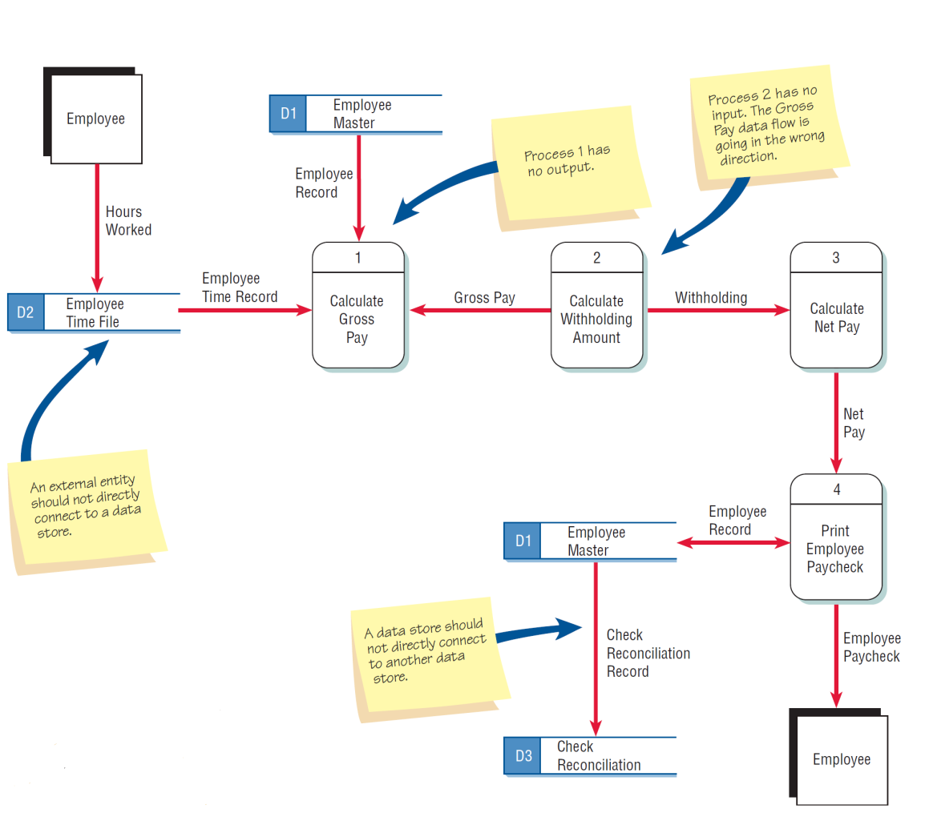
Figure 7.5 Typical Errors That Can Occur in a Data Flow Diagram

Slide 35
Physical and logical data flow diagrams
Section 3/5

Slide 36
Logical and Physical Data Flow Diagrams (1 of 2)
Logical
Focuses on the business and how the business operates
Not concerned with how the system will be constructed
Describes the business events that take place and the data required and produced by each event

Slide 37
Logical and Physical Data Flow Diagrams (2 of 2)
Physical
Shows how the system will be implemented
Depicts the system

Slide 38
Figure 7.7 Features Common of Logical and Physical Data Flow Diagrams
Design Feature | Logical | Physical
What the model depicts. | How the business operates. | How the system will be implemented (or how the current system operates).
What the processes represent. | Business activities. | Programs, program modules, and manual procedures.
What the data stores represent. | Collections of data regardless of how the data are stored. | Physical files and databases, manual files.
Type of data stores. | Show data stores representing permanent data collections. | Master files, transition files. Any processes that operate at two different times must be connected by a data store.
System controls. | Show business controls. | Show controls for validating input data, for obtaining a record (record found status), for ensuring successful completion of a process, and for system security (example: journal records).

Slide 39
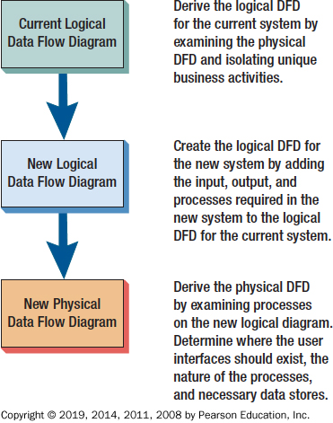
Figure 7.8 The Progression of Models from Logical to Physical

Slide 40
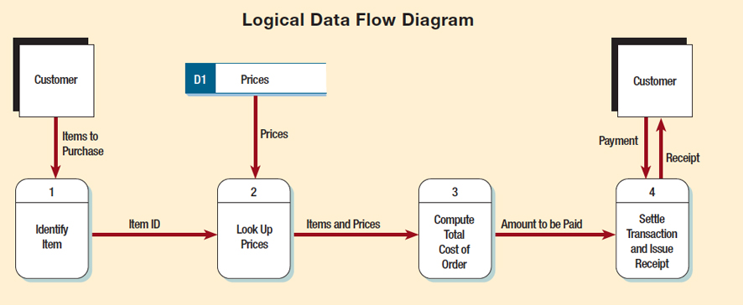
Figure 7.9 Logical Data Flow Diagram Example

Slide 41
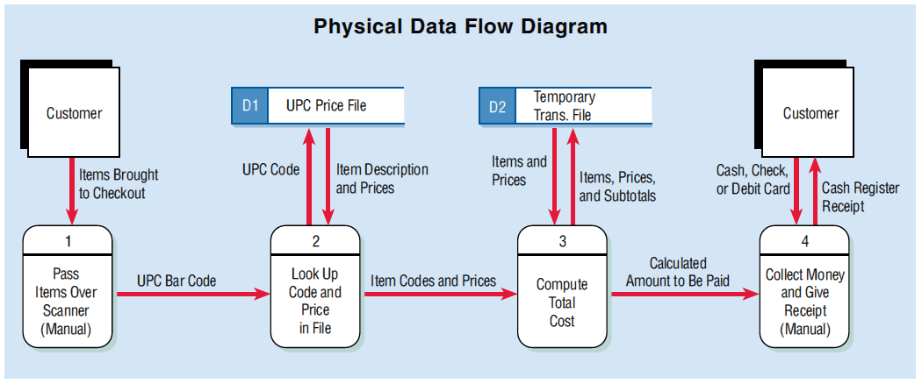
Figure 7.9 Physical Data Flow Diagram Example

Slide 42
Developing Logical Data Flow Diagrams
Better communication with users
More stable systems
Better understanding of the business by analysts
Flexibility and maintenance
Elimination of redundancy and easier creation of the physical model

Slide 43
Developing Physical Data Flow Diagrams
Clarifying which processes are performed by humans and which are automated
Describing processes in more detail
Sequencing processes that have to be done in a particular order
Identifying temporary data stores
Specifying actual names of files and printouts
Adding controls to ensure the processes are done properly

Slide 44
Physical Data Flow Diagrams Contain Many Items Not Found in Logical Data Flow Diagrams
Contents of Physical Data Flow Diagrams
Manual processes
Processes for adding, deleting, changing, and updating records
Data entry and verifying processes
Validation processes for ensuring accurate data input
Sequencing processes to rearrange the order of records
Processes to produce every unique system output
Intermediate data stores
Actual file names used to store data
Controls to signify completion of tasks or error conditions

Slide 45
CRUD Matrix
The acronym C R U D is often used for
Create
Read
Update
Delete
These are the activities that must be present in a system for each master file
A CRUD matrix is a tool to represent where each of these processes occurs in a system

Slide 46
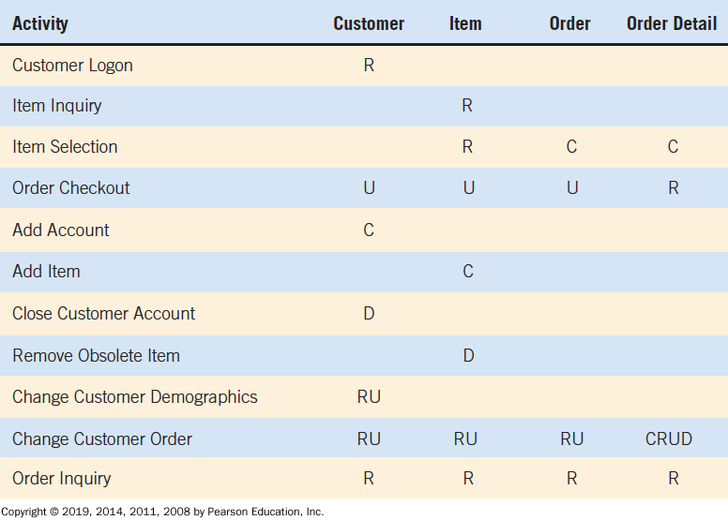
Figure 7.11 CRUD Matrix

Slide 47
Q&A
Ferdinand Hiagbe

